Slide 1
Gradle and Eclipse

Slide 2
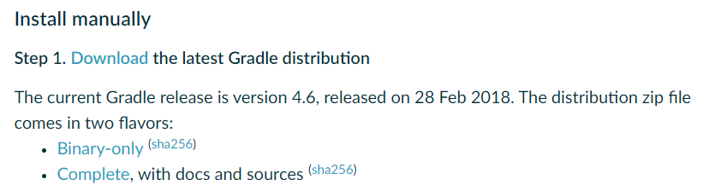
Download Gradle on Windows
Go to https://gradle.org/install/ and manually download the latest Gradle distribution.

Slide 3

Download Gradle on Windows
Create a new directory C:\Gradle, unzip the zip file and move the content folder to the newly created folder.

Slide 4
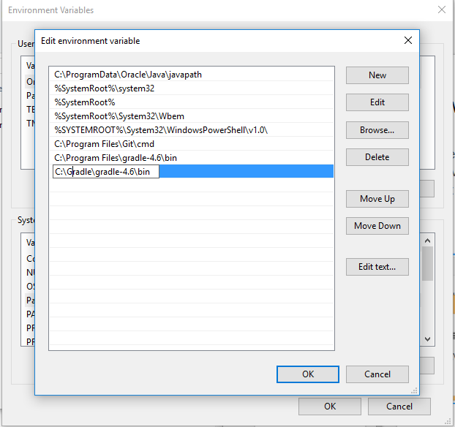
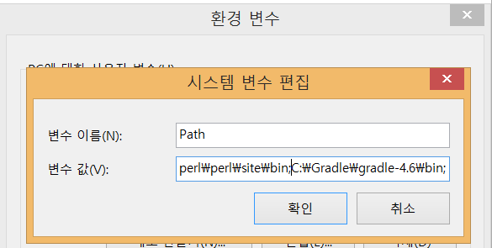
Download Gradle on Windows
In File Explorer right-click on the This PC (or Computer) icon, then click Properties -> Advanced System Settings -> Environment Variables. Under System Variables select Path, then click Edit. Add an entry for C:\Gradle\gradle-4.6\bin. Click OK to save.
Old Windows Windows 10

Slide 5
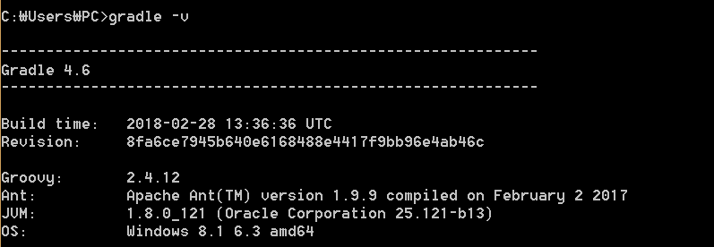
Download Gradle on Windows
Open cmd and run gradle -v to run gradle and display the version.

Slide 6
Create Java project using Gradle command line
Open cmd and go to the directory where you want to create Java project.
Type the command in yellow color as follows: The files and folders below are automatically generated.
Reference for additional information: http://www.mkyong.com/gradle/gradle-create-java-project-structure-automatically/
C:\your\project\directory> gradle init --type java-library
C:\your\project\directory> dir/w
[.] [..] .gitignore [.gradle] build.gradle [data]
[gradle] gradlew gradlew.bat LICENSE README.md settings.gradle
[src]
7 File(s) 47,265 bytes
6 Dir(s) 499,770,888,192 bytes free

Slide 7
Push your gradle Java project into your Github repository
Create remote (in Github) and local git repository for your gradle Java project(Slides: page 12 to 26)
https://docs.google.com/presentation/d/1gBkrNSednTSyCyy2qkJprPHoK9LXydoB2sAW9M_fGv4/edit#slide=id.g345b3cd1e4_0_23
Use git in Eclipse
https://docs.google.com/presentation/d/1dMNuQ_fL9YwxC7DGExaKG3_O5lTtm5f_qirig4Tho1Q/edit#slide=id.p

Slide 8
Basic Gradle commands
c:\path\to\project\> gradle build // assembles and tests the project.
c:\path\to\project\> gradle test // runs the unit tests.

Slide 9
Useful gradle commands

Slide 10
Install Gradle plug-in for Eclipse

Slide 11
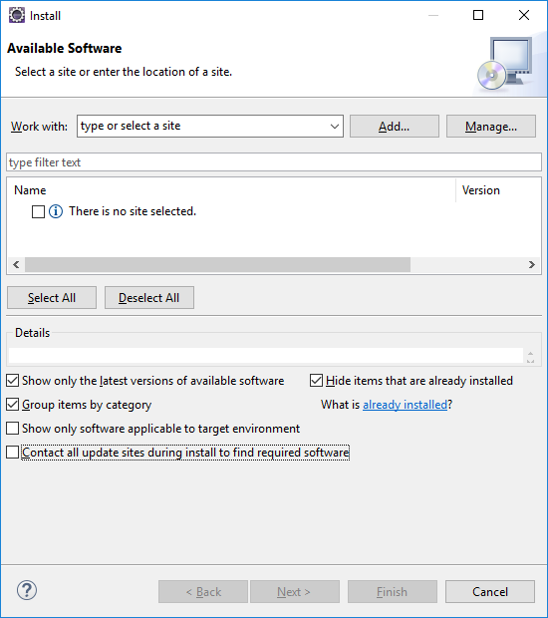
Install Gradle plugin in Eclipse
In Eclipse, Help menu → Install New Software…

Slide 12
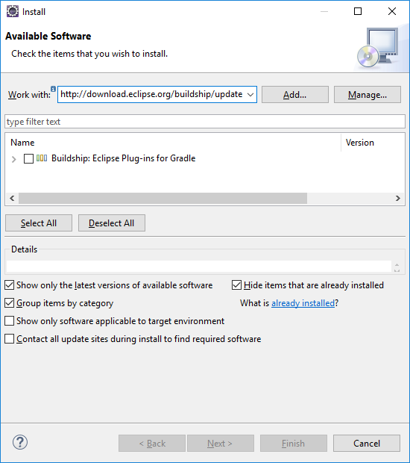
Install Gradle plugin in Eclipse (2)
Add the following Repository address(http://…) in the "Work with:" field and click "Add" button
http://download.eclipse.org/buildship/updates/e47/milestones/2.x
Put "Name:" Buildship

Slide 13
Install Gradle plugin in Eclipse (3)
Tick Buildship: Eclipse Plug-ins for Gradle
Click Next, accept the agreement, and progress the installation.

Slide 14
Import your gradle java project into Eclipse with git
Make your gradle java project for a git repository
Check slides from here
https://docs.google.com/presentation/d/1gBkrNSednTSyCyy2qkJprPHoK9LXydoB2sAW9M_fGv4/edit#slide=id.g345b3cd1e4_0_23
As you created your gradle java project in Page 6, import it in Eclipse.
https://docs.google.com/presentation/d/1dMNuQ_fL9YwxC7DGExaKG3_O5lTtm5f_qirig4Tho1Q/edit#slide=id.p

